Slide 1

State of the QA and UI

Slide 2
Acceptance Tests
Created Master Page
Created User Information Table
Created Landing Page (Index)
Created Sign-Up page

Slide 3
Acceptance Tests
Created message Framework
Created encryption Framework
Created search Feature
Created message Dashboard

Slide 4
Acceptance Tests
Created One-on-one communication.
Notify user about the new messages
Created admin dashboard

Slide 5
Acceptance Tests

Slide 6
User interface
Bootstrap: Primary framework
Total number of Pages : 5
Primary Color: (#1E90FF) Dodger Blue,
.

Slide 7
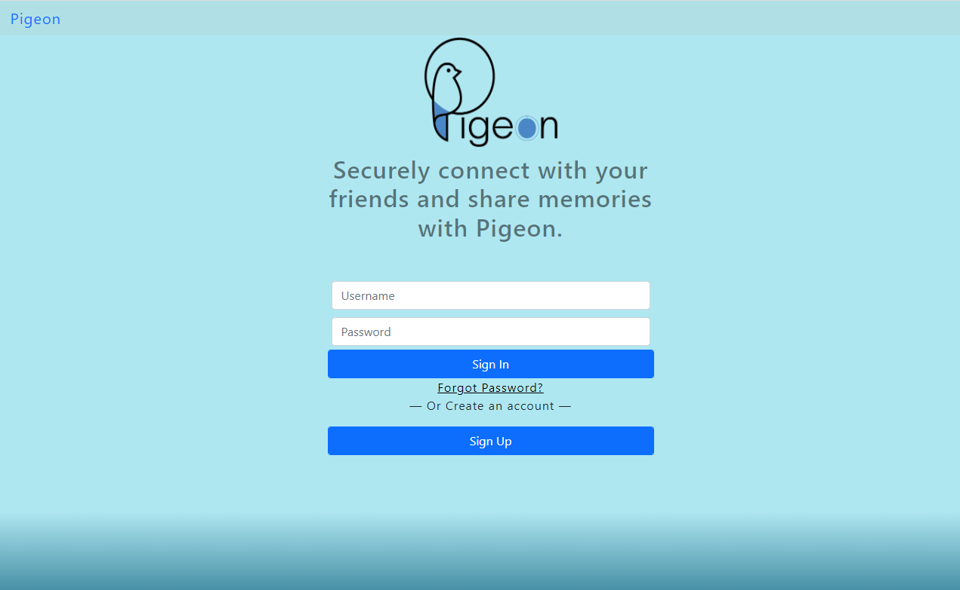
Index / Log-In

Slide 8
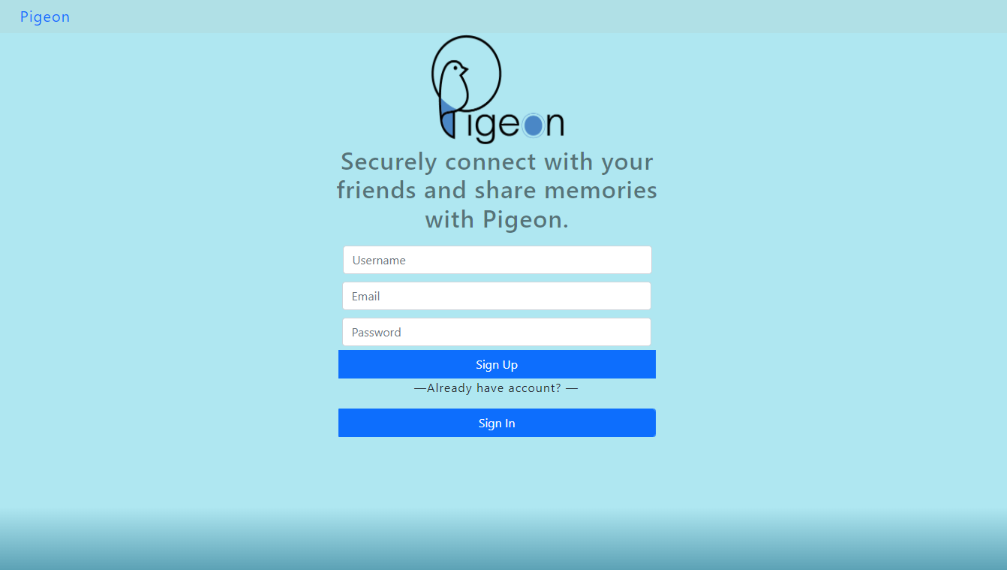
Sign up

Slide 9
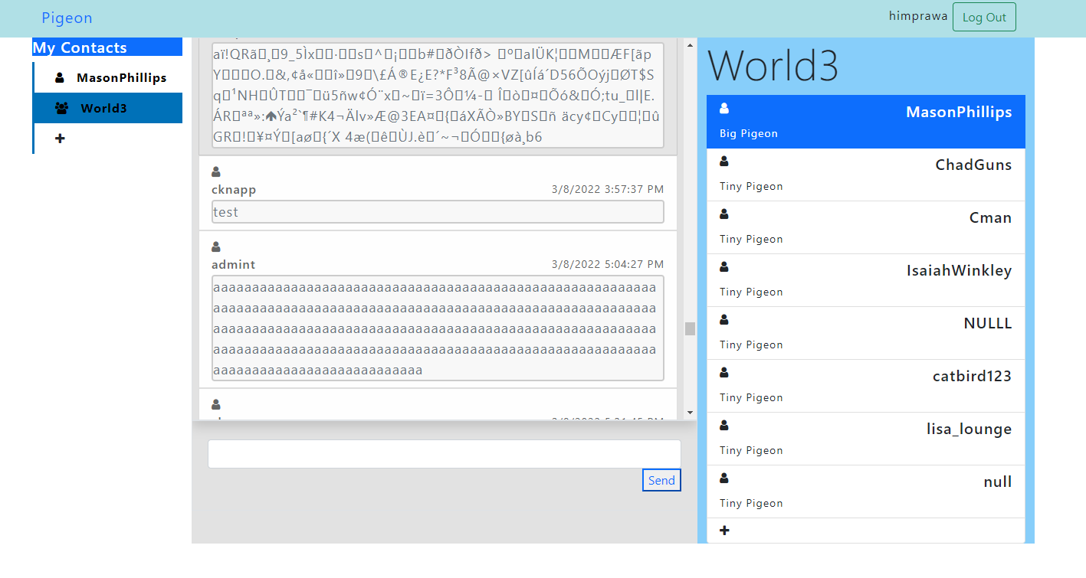
Nest

Slide 10
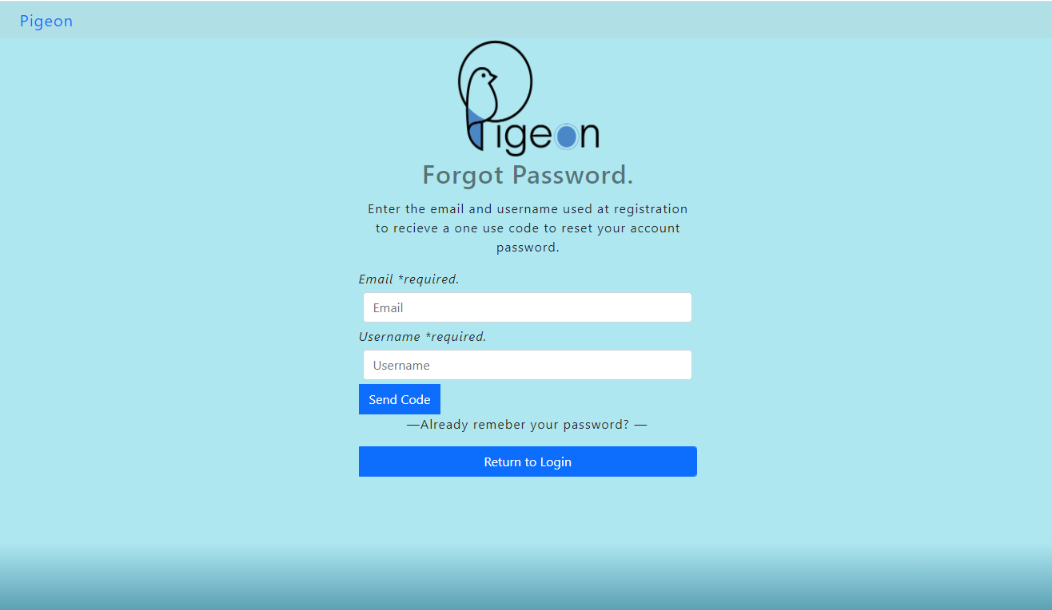
Forgot Password

Slide 11
Admin Dashboard

